Slide 1
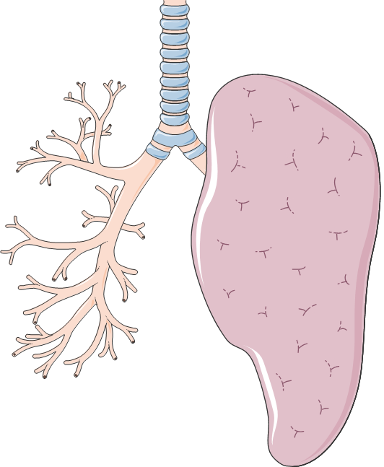
Sputum microbiome profiles identify severe asthma phenotypes of relative stability at 12-18 months
Airway obstruction
More severe
asthma
Pathogenic bacteria
Severe adult asthma patients
Neutrophils
Unsupervised microbiome-driven clustering
Cluster 2
Macrophages
12-18 month
follow-up
Cluster 1
Baseline
Less severe
asthma
Commensal bacteria
Sputum microbial signature assessment
2 robust microbiome clusters with relative stability after 12-18 months

